Slide 1
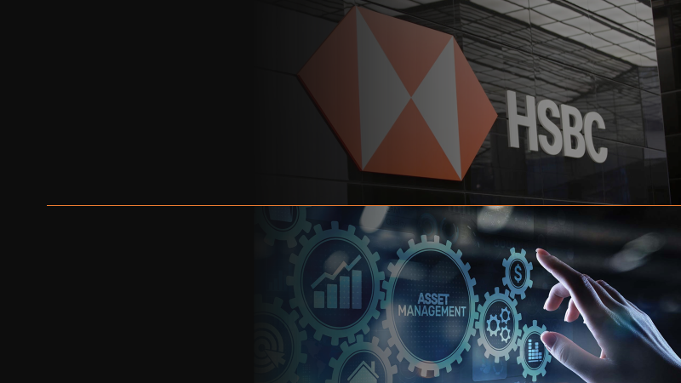
HSBC Global Private Banking Case Challenge
Team AlphaGoal
A holistic portfolio team for managing your wealth

Slide 2
Executive Summary
Overview
What Differentiate Our fund?
Aggressive Mix
High return is achieved by including alternative funds including REITS from U.S. and Europe.
A detail-minded asset hedging approach has been used to achieve this return at minimal risk.
Diversified Investment Location
We includes a variety of products from the globe to capture more investment opportunities.
This also minimizes the region-specific risks and allow the portfolio to have smaller volatility.
New Mindset of
Investment
Unlike traditional portfolio, we allocate a large portion of capital in alternatives rather than traditional equities and fixed income as recession risks are high.
Risk Positioning Map
Key Performance Indicators
Return
7.6710% /year
Volatility
9.0100% /year
Return
*
Our Portfolio
Sharpe Ratio
0.5261
Volatility
Overview

Slide 3
Client Risk and Return Profile
Overview
1
Diversified investment portfolio; alternatives emphasized
Aggressive Profile of
USD 50,000,000
The client prefer to invest in manifold industries through funds, worries over single-line equities and fixed income.
With the pessimistic market sentiment on inflation and a potential recession, the client is willing to diversify the risks by bringing alternatives investment into the portfolio.
2
High risk tolerance level; aggressive investing philosophy
High
✔
The client owns 45% shares of the listed company Biotech Asia Pacific, estimated to be worth USD 90 million; can be pledged.
The client has no short-term liquidity need.
The client favors aggressive strategies, and is optimistic in taking relatively more risky investments.
Asset Risk Level Expected
Low
3
High capital gain required; offsetting tuition fee expected
Low
High
With the risk-bearing investment tactics, the client requires and expects higher return on capital employed.
Two children plan to study at top-tier US universities in two and four years respectively, with tuition fee of around USD 55k per year for each child (require 0.1 million stable cash inflow 4 years from now).
Risk Tolerance Level
Overview

Slide 4
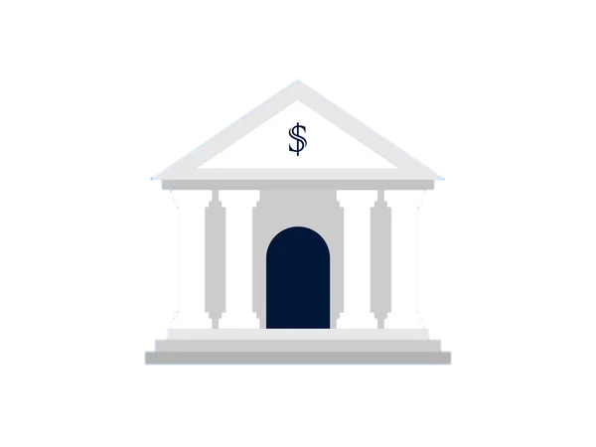



Major Global Events
Bright Lights or Dim Future?
Rate hike
Capital flow back to the US,
strengthening dollar.
Debt distress in emerging
economies.
China zero-covid policy
New waves of confirmed cases perpetuates China’s strict COVID policies.
Ukraine War
Longer-than-expected war duration is messing up the supply chain. And Russia may suspend the Nord Stream Pipeline to deter European nations.
Overview

Slide 5
Bright Lights or Dim Future?
Global Outlook by Regions
 | Developed Markets |  |  | Emerging Markets
Country/ Region | US | EU | JP | China | EM ex-China
Tailwinds | + Resumed business policy + Unemployment rate is at low level + High interest rate | + Resumed flights in Schengen Area + Brexit has been less troubling than expected | + Ultra easy monetary stimulating economy + Inflation rate remains low + Opening border for individual tourists soon | + Trade wars with US are watered down + Attractively low lending rate offered by central bank | + Shift of global supply chains + With relieved COVID policies, economy may blossom
Headwinds | - Persistent inverted yield curve, wary of recession - Inflation rate is at four decades high, with little sign of easing - Powell hinted monetary policy will stay restrictive in Jackson Hole speech | - Tensions in Ukraine have no signs of easing - Potential energy crisis due to heavy reliance on Russian gas supply. - Decades-high inflation hovering | - Domestic demand has been suffering from sluggish growth - Very low birth rate, labor cost and supply could be harsher in near future | - Strict quarantine and lockdown policy - Escalation of property sector crisis - Taiwan problem induced new tensions with Western nations | - Harder to issue bond as liquidity tighten and some countries defaulted - Rising food and energy prices could cause widespread food insecurity and social unrest
Growth Projection | 2021: ~5.7% 2022: +2.4% | 2021: ~5.4% 2022: +2.7% | 2021: ~1.6% 2022: +1.7% | 2021: ~8.1% 2022: +3.0% | Varies
Overview

Slide 6
Bright Lights or Dim Future?
Global Outlook by Asset Classes
US Treasury Bills Yield Curves (Aug 31, 2022)
Fixed Income
Equities
Alternatives/
Thematics
Inverted
The rising inflation causes the Fed to rapidly raise the interest rates.
The market holds pessimistic views on the US, preferring lower-risk products.
The yield curve is inverted, probably implying a potential recession.
Debt distress raises the risk of default on fixed incomes at emerging markets. But it could also mean higher potential return.
Higher Fed rates raises investors’ expectation in equity returns.
Potential recession in the US deters global investments as investors expect lower growth.
US Equity value could dip, by various banks and analysts.
With ultra-QE policy in Japan, stock price may not follow the trends in the US.
The great variation in money value pushes investors in invest in alternatives, such as real estates.
Pushing up US and EU property market price by around 30% and 15% respectively from 2020 to 2022.
ESG-related market, such as renewable energy sector, has a long-term market potential. Higher risks but higher returns.
FED Total Assets Value
Tapering &
reinvest
US$ trillion
Quantitative
Easing
Pandemic
QT
2008
2014
2018
2020
2022
2026
95B per month
Overview

Slide 7


Riding through The Volatility
Portfolio Justification
Fundamental logic
The shrinking money supply and weaker nominal growth will likely be a formidable headwind for risky assets. Therefore, we suggest underweighting equities in the near term.
The major composition of this part will be US investment grade and high yield corporate bonds. They can provide a stable cash inflow, fulfilling the clients need of cash flow to support his children education expenses.
Under the Fed’s tightening policy, US dollar index jumps over 109. Although the high bond yield of emerging market local currency debt is lucrative, the yield cannot compensate the risks after considering the negative exchange rate impact.
20%
Fixed-income
Private real estates investment trust (REIT) has a highly promising Sharpe ratio of around 1.23, it can offer stable and income generating product.
The nature of the product can act as an inflation hedge.
Real estate has negative correlation with equities (of around -0.2), hence providing risk divergence, and hence, reducing the unsystematic risks.
Hedge funds can keep generating profits even under market downturn through hedging.
55%
Alternatives
Portfolio Mix
Notes:
Add “could not validate partnership model”

Slide 8

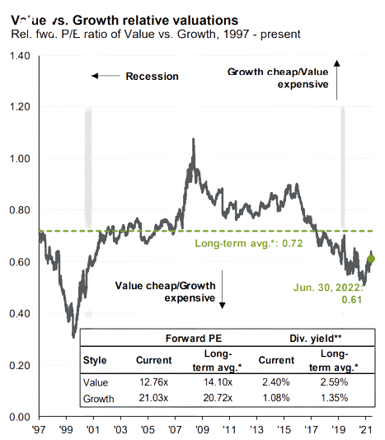
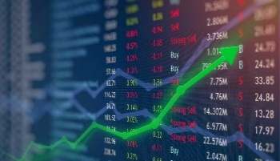
Riding through The Volatility
Portfolio Justification
5%
Thematics
Value vs. Growth relative valuations
P/E ratio of Value vs. Growth, 1997 - present
ESG investing does not mean giving up potential return as many ESG events have material impact on the company, thus affecting the share price.
For instance, Activision Blizzard shares dropped significantly after sexual harassment scandal.
ESG investment can fulfill social responsibility while fulfilling the need of clients.
A relatively low weighting is because ESG is still not well-defined and there are high uncertainty involved.
In the short term, we will put a greater focus on Japanese equities as the Bank of Japan maintains ultra easy monetary policy as it is not having any inflation concern. We can benefit from relatively low volatility and high return.
It is still not the time to buy the dip for US stocks as the growth stocks are still overvalued comparing with value stocks, so a relatively low weighting is assigned
20%
Equities
Portfolio Mix
Notes:
* Explain why did we choose the % explictly

Slide 9
Portfolio Construction
Overview
TAA Asset Distribution
Fixed Income
Funds | SAA (%) | TAA (%)
Fixed Income | 20 | 20
U.S Inv Grade Corporate Bonds | 5 | 5
Emerging Markets Sovereign Debt | 15 | 15
Equities | 25 | 20
U.S Equity | 10 | 5
Japanese Equity | 5 | 10
AC Asia ex-Japan Equity | 10 | 5
Thematics | 10 | 5
Investing in a Sustainable Future (ESG) | 10 | 5
Alternatives | 45 | 55
Multi-Strategy Hedge Funds | 5 | 5
Real Estate Liquid Alternatives | 40 | 50
Total | 100 | 100
20%
Alternatives
55%
Assets
by Classes
Equities
Thematics
20%
5%
Global
10%
Japan
10%
US
Assets
by Regions
40%
Emerging Market
and Asia
20%
Europe
20%
Portfolio Mix

Slide 10
Portfolio Financing
Looking at the Performance
Funds Selected | Wgt | AR
U.S Inv Grade Corporate Bonds
JPMorgan Income | 5% | 70%
Emerging Markets Sovereign Debt
HSBC GIF RMB Fixed Income USD | 10% | 80%
JPMorgan Emerging Markets Investment Grade Bond | 5% | 70%
Funds Selected | Wgt | AR
U.S Equity
Morgan Stanley Global Quality | 5% | 70%
Japanese Equity
Pictet Japanese Equity Opportunities USD(H) | 10% | 70%
AC Asia ex-Japan Equity
FSSA Asian Equity Plus | 5% | 70%
Funds Selected | Wgt | AR
Investing in a Sustainable Future (ESG)
Schroder Global Energy Transition | 5% | 70%
Hedge Funds
Global Multi-Strategy | 5% | 50%
Liquid Alternatives
US Private REIT | 30% | 50%
EU Private REIT | 20% | 50%
Before
Shares Pledging
Portfolio Weighted Advance Ratio
60.00%
Cash Outlay Required
USD 20,000,000
Pledging Advance Ratio
45.00%
Value of Shares to be Pledged*
USD 44,450,000
%shares to Pledge
22.22%
Shares Pledging
* Rounded up to nearest 4 significant figures
Portfolio Analysis

Slide 11
Looking at the Performance
Returns and Sharpe Ratios by Regions
United States (40%)#
Expected Return: 8.3725%
Sharpe Ratio: 0.7576
Europe (20%)#
Expected Return: 9.9300%
Sharpe Ratio: 1.2344
Overall Return (Before Interest)
7.6710% /year
Overall Return (After Interest)
5.4210% /year
Japan (10%)#
Expected Return: 6.7000%
Sharpe Ratio: 0.2538
Sharpe Ratio (Before Interest)
0.5261
Sharpe Ratio (After Interest)
0.2764
Emerging Markets and Asia (20%)#
Expected Return: 5.6500%
Sharpe Ratio: 0.2306
Global (10%)#
Expected Return: 5.3600%
Sharpe Ratio: 0.2095
* US 90-day T-Bill yield: 2.931%
# Before borrowing interest expense
Portfolio Analysis

Slide 12

Earning Profits while Making the World Better
ESG investing
ESG stands for Environmental, Social, and Governance. Investors are increasingly applying these non-financial factors as part of their analysis process to identify material risks and growth opportunities.
Why ESG?
Key Achievements of HSBC PB
Reducing risks
Some multinational enterprises have suffered substantial drops in stock prices following ESG risk events such as labor exploitation.
1
We published latest ESG information alongside our annual report.
Beating the market
Due to higher credit rating and lower risks, companies with strong ESG metrics are more likely to outperform the market.
Our Green Bond Framework has been certified as “Dark Green” by CICERO Shades of Green.
2
Our sustainable investment is growing rapidly, with 65% of accumulated investment happened in 2021. We aim to invest 1 trillion by 2030.
Capturing opportunities
These companies are better equipped to serve new demand, such as decarbonization and net zero.
3
ESG Investing

